Slide 1
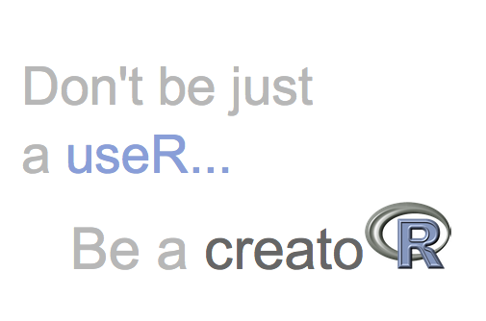
Creating R Packages A Foundation for Bioinformatics Tool Development
Aubrey Odom, PhD
Johnson Lab Meeting
6/26/25

Slide 2
Today’s Agenda
Anatomy of an R Package
Creating a Package
Writing Good Documentation
Best Practices
Wrap-up / Q&A
Introduction

Slide 3
Introduction

Slide 4

What is an R package?
Structured collection of R functions, data, and documentation
Standardized directory layout
Metadata describes functions & dependencies
Easily shared and reused

Slide 5
Why turn your R code into a package?
Reusability
Consistent use across multiple projects.
Reproducibility
Reliable and repeatable analyses
Collaboration
Easy to share with others
Modularity
Break up complex workflows
Documentation
Generate usage + help files
Testing and Validation
Ensure robust code over time
Distribution
GitHub, CRAN, Bioconductor
Tooling Support Convenient R development tools (devtools)

Slide 6
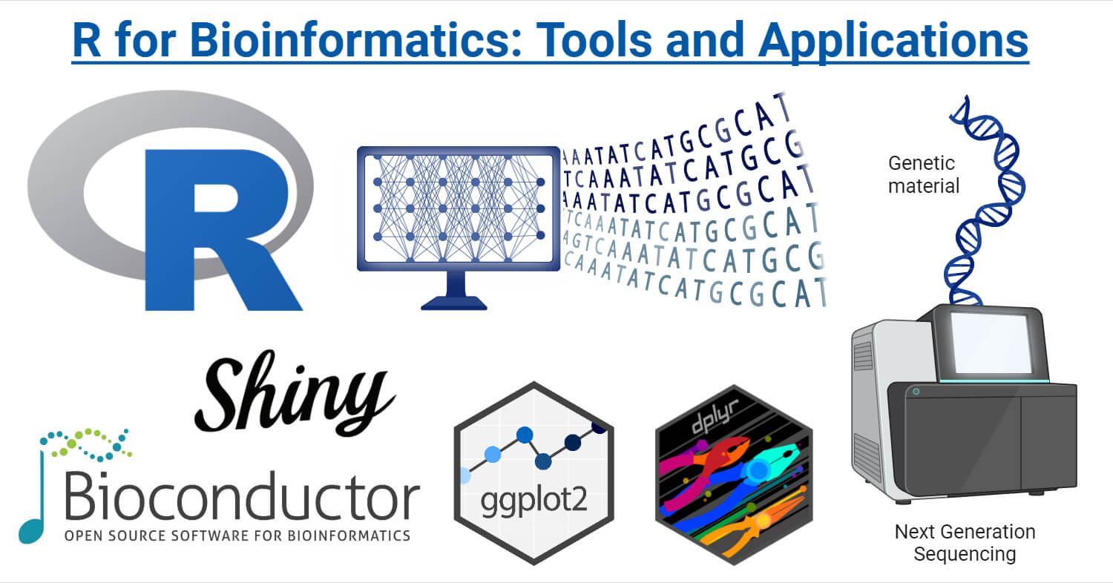
Bioinformatics & R Packages
Tools for large ‘omics datasets
Cross-discipline collaboration
Command-line for advanced users
R Shiny apps for non-computational scientists
Standardizes workflows across projects and teams
Reproducible for publishable analyses

Slide 7
When should I make a package?
📏Rule of thumb:
If you’ve copied a function into a second project — it’s time to package it.
⚠️Other warning signs:
Code reused across projects
Code has growing complexity
Needs documentation
Will be shared with others
Is a toolkit or analysis pipeline

Slide 8

Johnson Lab Famed Software
Package Name | Purpose
BatchQC | User interface for interactive evaluation of batch effects in -omic data
sva (ComBat) & ComBat-seq | Batch-effect correction using empirical Bayes
PathoScope 2.0 | DNA metagenomic strain identification framework (NOTE: Python…)
animalcules | Interactive microbiome R/Shiny toolkit
MetaScope | R‑based strain-level metagenomic profiling
LegATo | Longitudinal microbiome analysis tools
curatedTBData | Harmonized TB transcriptomic dataset aggregator
TBSignatureProfiler | TB gene-signature scoring and profiling
ASSIGN | Bayesian factor regression for genomic signature identification
*
*
*
*
*
*
*
*Packages I have created/contributed to
https://wejlab.github.io/
*Packages I have used

Slide 9
Anatomy of an R Package

Slide 10
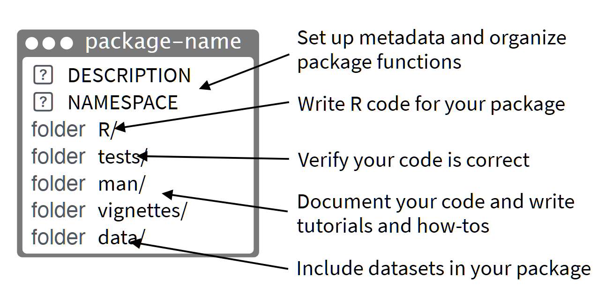
Core Components
Required components in red
From Rstudio cheatsheet

Slide 11
Core Components (cont.)
R/ – Contains all your R scripts (functions, methods, etc.)
man/ – Auto-generated documentation (help files for each function)
DESCRIPTION – Metadata: title, author, dependencies, version, etc.
NAMESPACE – Controls what functions are exported/imported
Example: https://github.com/wejlab/legato

Slide 12
Optional Components
Optional components in blue
From Rstudio cheatsheet

Slide 13
Optional Components (cont.)
data/ – Stores example datasets (as .rda files)
vignettes/ – Long-form documentation/tutorials (R Markdown)
tests/ – Unit tests using frameworks like testthat
inst/ – Extra files (e.g., templates, external scripts, Shiny apps)
Example: https://github.com/wejlab/MetaScope/

Slide 14
Package Lifecycle
Development
Write code, document, and structure using devtools
Testing
Add tests, check for errors with
R CMD check
Documentation
Generate help files and vignettes
Release
CRAN, Bioconductor, or share via GitHub
Maintenance
Fix bugs, update code, version control

Slide 15
Development Tools Every R pkg developer becomes very familiar with these packages ☺
devtools
Simplifies package creation and development
usethis
Automates setup of common files (DESCRIPTION, tests, etc.)
roxygen2
Write documentation alongside your code with special comments
testthat
Framework for writing unit tests in R

Slide 16
Creating an R Package

Slide 17
Starting a New Package (option 1)
Use usethis::create_package("path/to/pkg") to initialize the structure
Automatically sets up: DESCRIPTION, NAMESPACE, R/, .Rproj
Creates a Git-ready, RStudio-friendly project
Recommended: use a clean directory (not inside an existing project)

Slide 18
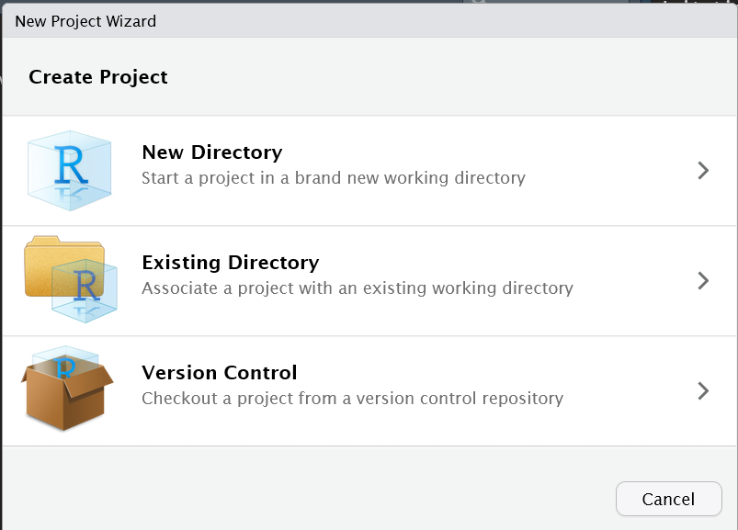
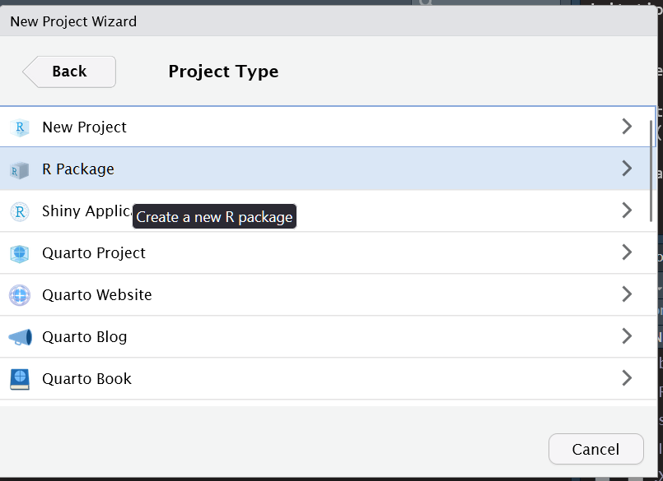
Starting a New Package (option 2)
New Project in Rstudio -> Select Folder Location -> R Package

Slide 19
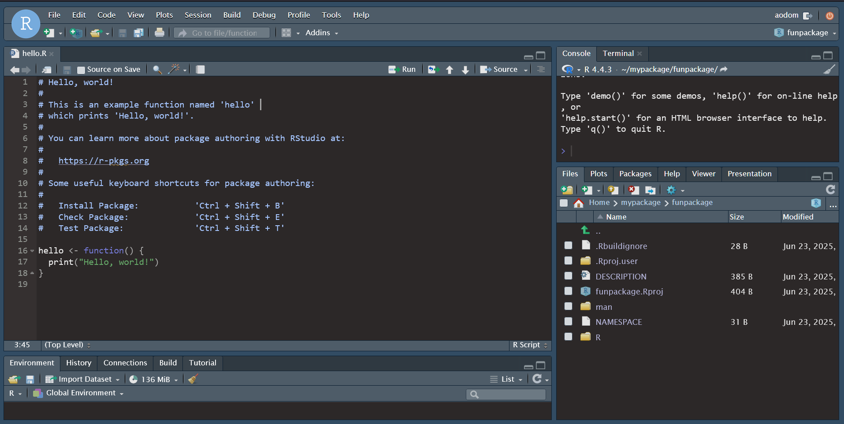
Option 2 (cont.)
This is the first thing you’ll see after the package is created.

Slide 20
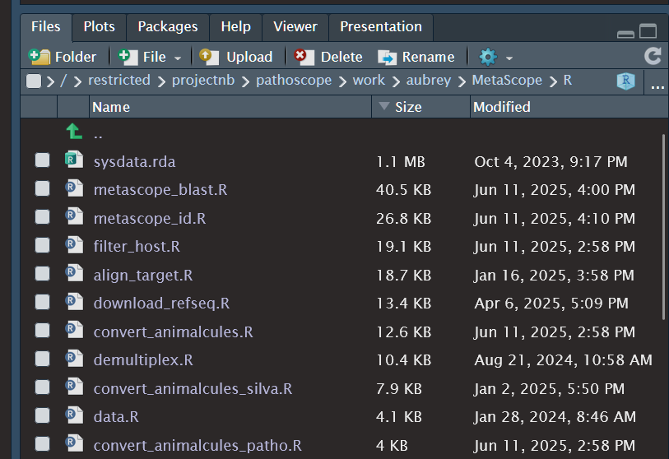
Adding Functions Writing and Organizing Code in R/
Place all functions in .R files inside the R/ folder
Tips:
Group related functions into logically named files
e.g., utils.R, plot_methods.R
Or, one file per function (with helpers)
Use consistent function names and style
Use helper functions liberally
Document each function with roxygen2 comments
Example: MetaScope scripts

Slide 21
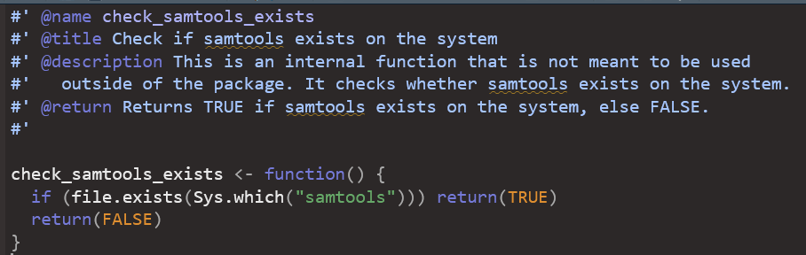
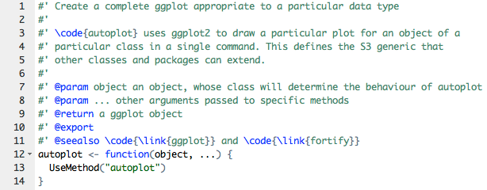
Documenting with roxygen2
Add documentation directly above functions using #' comments
Key tags:
@param – Describe each function argument
@return – Explain what the function returns
@examples – Include runnable example code
Generating help files:
roxygen2::roxygenise()
Ctrl+Shift+D in Rstudio

Slide 22
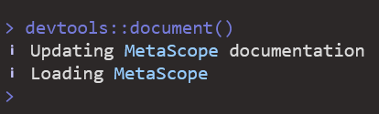
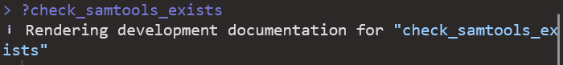
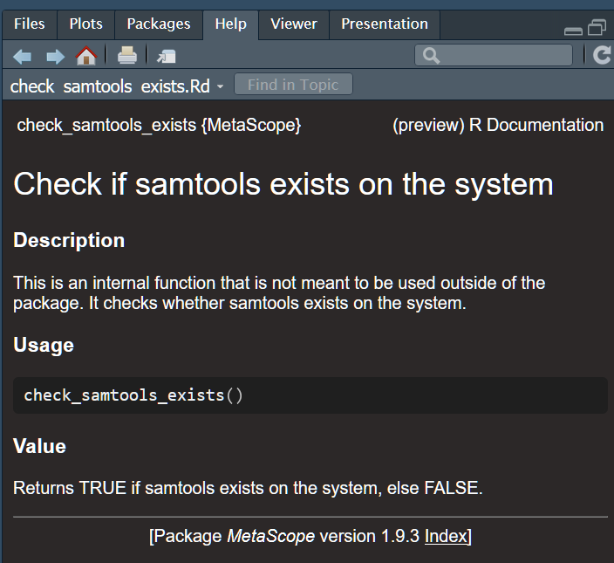
Generating Help Files
Use devtools::document() to convert roxygen2 comments into .Rd help files in man/
POPULATES THEM AUTOMATICALLY!!
Updates the NAMESPACE file based on @export, @import, and other tags
Run this command after adding or editing function documentation
Shortcut in RStudio: Ctrl+Shift+D
Access with ?function_name
Example documentation:

Slide 23
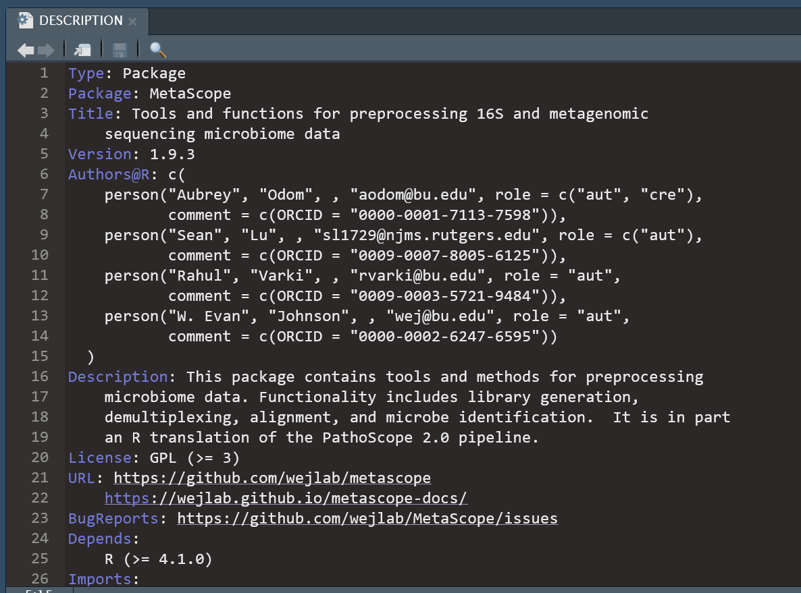
Editing the DESCRIPTION
usethis::use_tidy_description()
The DESCRIPTION file defines your package's metadata:
Package name, version, title, author, license
Imports: lists other packages your code depends on
Optional fields: Suggests, Depends, BugReports, URL

Slide 24
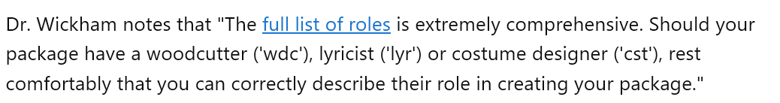


DESCRIPTION Roles
https://www.loc.gov/marc/relators/relaterm.html
https://wejlab.github.io/LegATo-docs/

Slide 25
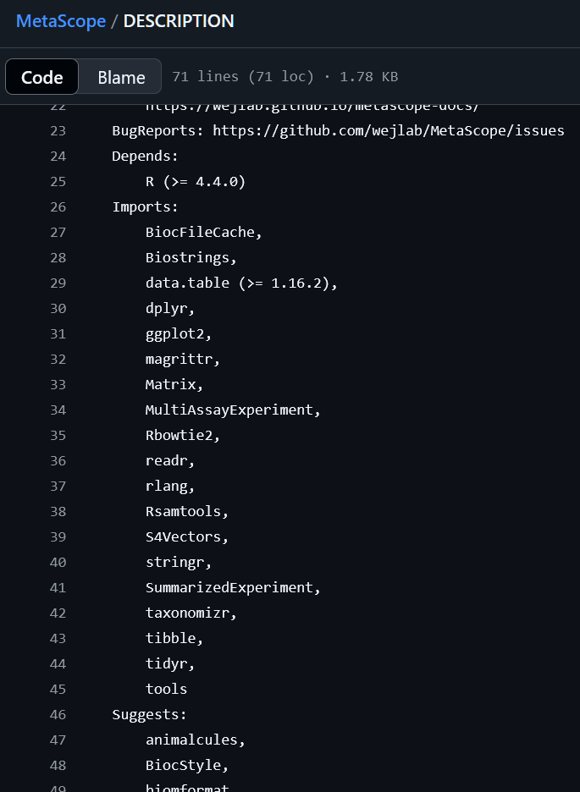
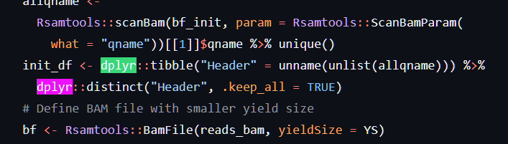
Managing Dependencies
Declare required packages in DESCRIPTION under Imports:
Use usethis::use_package("pkgname") to add safely
Call external functions using pkg::function() or add @import in docs
Avoid loading unnecessary packages — keeps your package lightweight
Avoid dependency hell 🔥

Slide 26
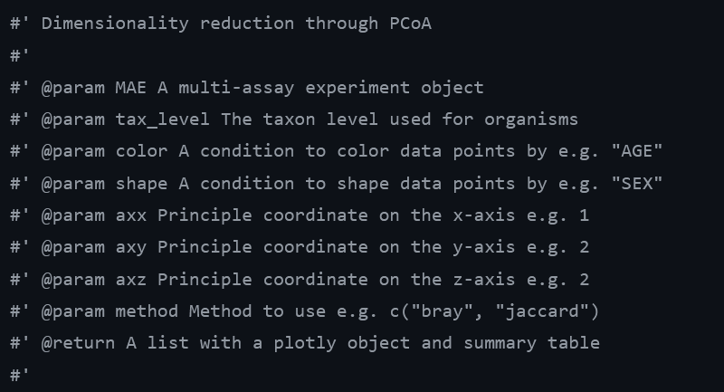
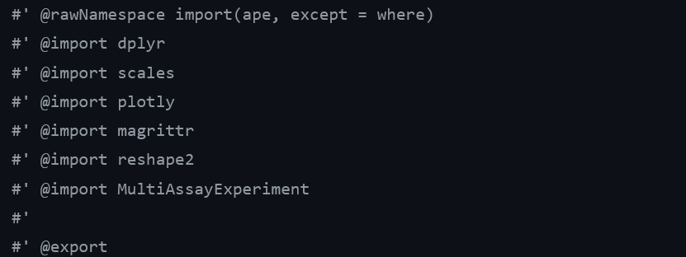
Managing Imports/Exports
The NAMESPACE file tells R which functions to export and which packages to import
Automatically generated using devtools::document()
Use roxygen2 tags:
@export – Makes your function available to users
@import <pkg> or @importFrom <pkg> function – Brings in external functions
** @import Not recommended

Slide 27
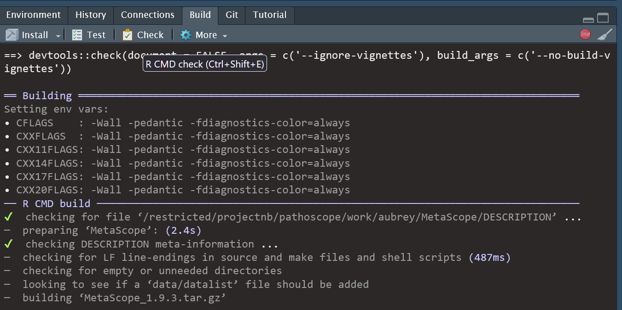
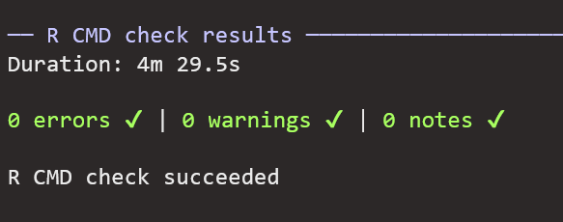
But does it work??
Click this one
Use Build pane in Rstudio
Runs tests, builds documentation, and checks code style and structure
Common outputs:
Errors – Code breaks or missing files (must fix)
Warnings – Potential issues (e.g., undocumented functions)
Notes – Minor CRAN policy concerns (fix if submitting)
Goal: A clean check with 0 Errors, 0 Warnings, 0 Notes

Slide 28
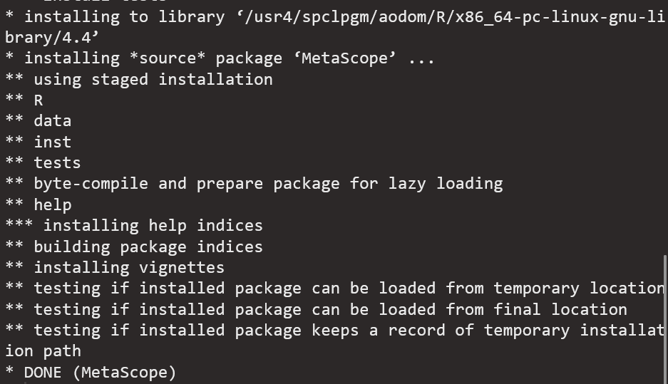
Installing and Loading the Package
Use devtools::document() to load package
Loads it into your session just like any other package
i.e. library(yourpkg)
Install locally with devtools::install_local()
Useful for using the package in a different local R project
Must pass R CMD Check…

Slide 29
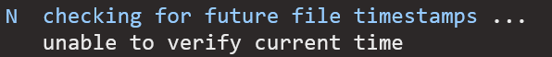
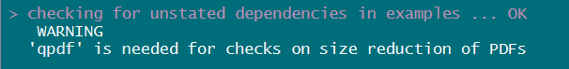
Nothing-burger Notes
Ignore these if you get them

Slide 30
Writing Good Documentation

Slide 31

Why Documentation Matters
Package will be usable + understandable
Helps others (and future you) use your code without digging into the source
Reduces support requests and debugging time
Required for Bioc submission
Well-documented packages get used, cited, and trusted

Slide 32
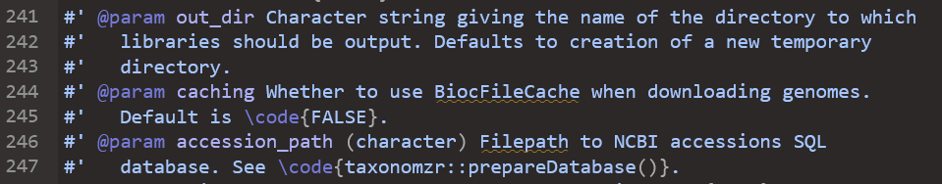
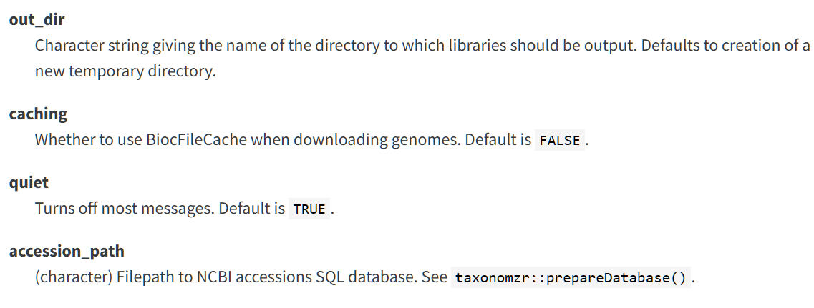
Function Docs: Best Practices
Use roxygen2 comments directly above each function
Include:
@param – describe all arguments clearly
@return – explain what the function outputs
@examples – provide runnable code examples
@export – if the function is for users
Aim for:
Concise yet informative
Clarity over completeness

Slide 33
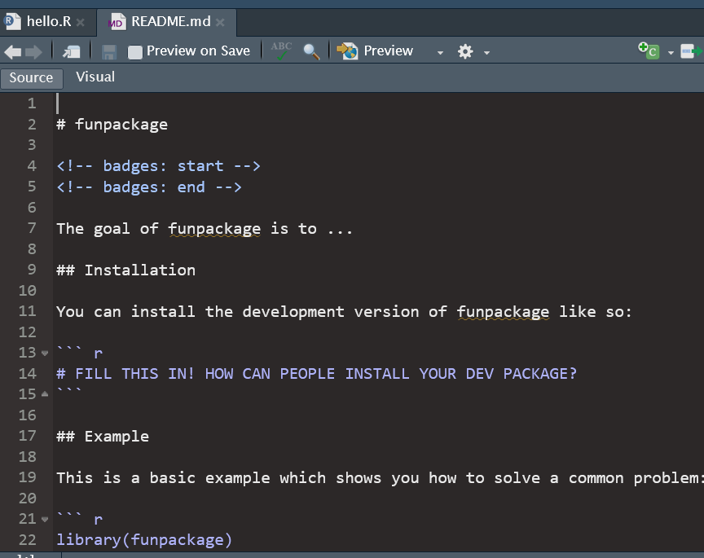
Creating a README
Use usethis::use_readme_rmd() to create a markdown-based README
Include:
What the package does
Why it exists
How to install it
Quick example of usage
Renders to README.md for GitHub display
Keeps your project welcoming and informative for new users

Slide 34
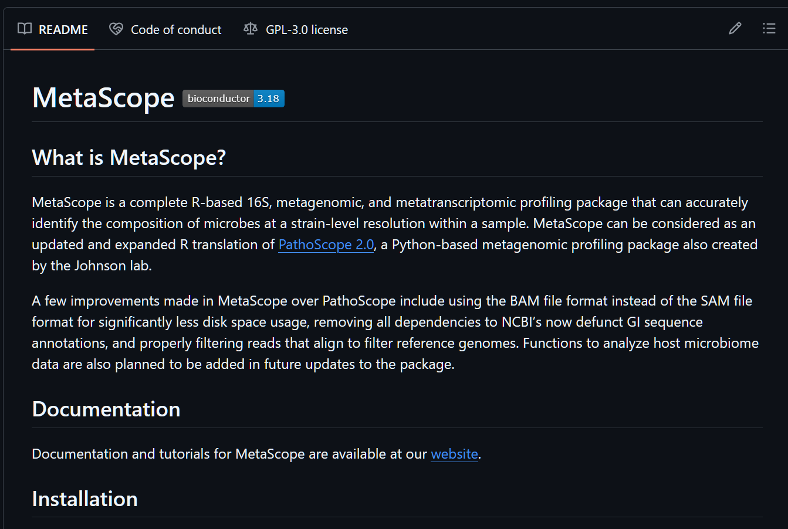

Slide 35


Upcoming: Sharing YouR Package
Thurs 7/17: My last (?) presentation in this lab meeting series
Topics include:
Mkdocs websites
Vignettes
Unit tests
CRAN vs. Bioconductor
Bioc submission standards
Bioc review process
Maintenance of ‘live’ packages
Your
R Package

Slide 36
Best Practices

Slide 37

Tidyverse Coding Style Guide
Adopt the Tidyverse Style Guide for:
Naming – snake_case for functions and variables
Indentation – 2 spaces, no tabs
Spacing – spaces around =, after commas
File structure – group related functions logically
Use styler::style_pkg() to auto-format your code

Slide 38
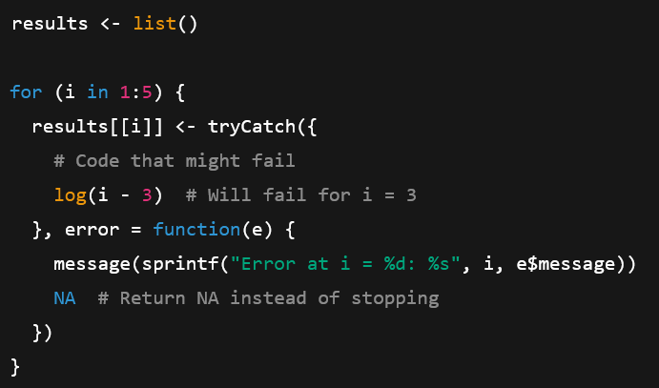
Error Handling and Logging
Write clear error messages with stop(), warning(), and message()
Be descriptive: tell the user what went wrong and why
Use tryCatch() to figure out what went wrong in a for loop
Use LLMs to help you write tryCatch() functions if they confuse you

Slide 39
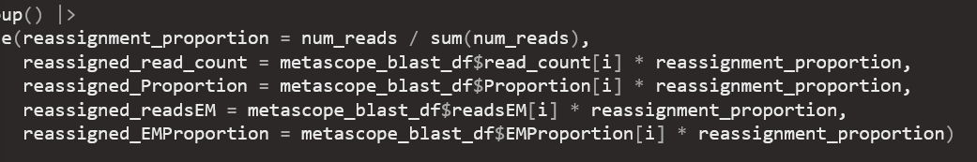

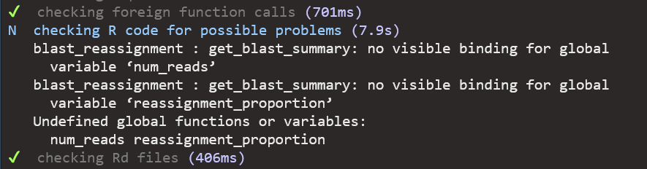
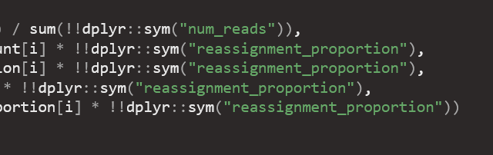
“No visible binding” error Stems from dplyr
Broken code
R CHECK note
Fixed Code 🥇
“no visible binding”

Slide 40
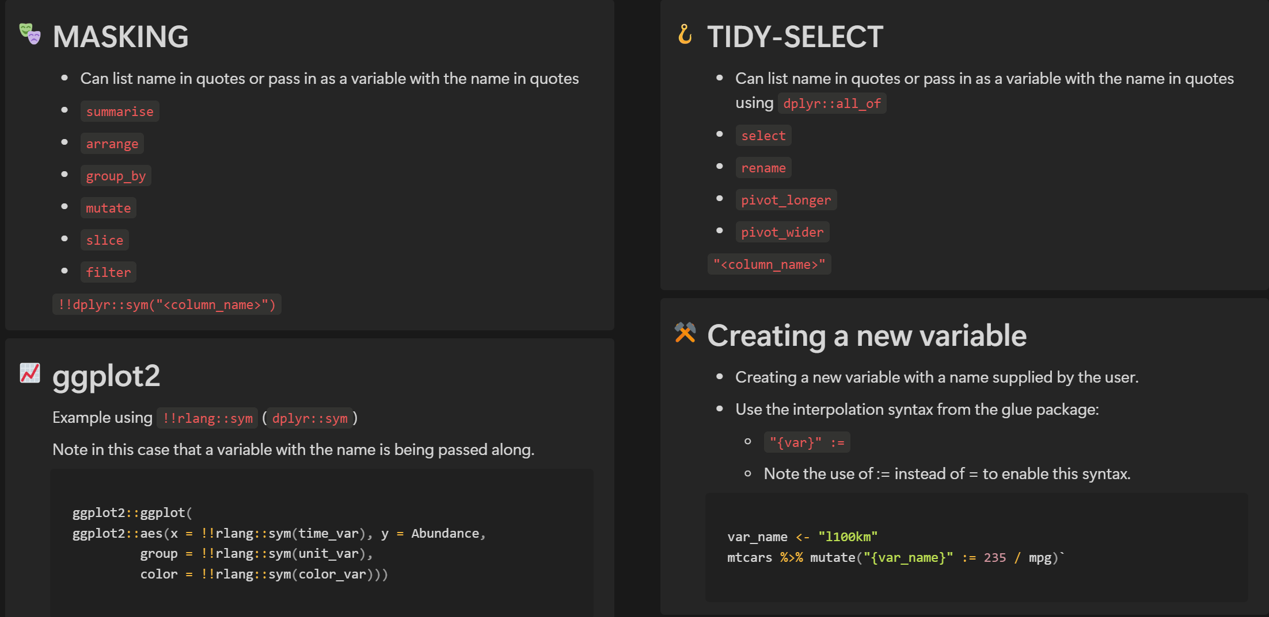
Working with dplyr inside functions
https://dplyr.tidyverse.org/articles/programming.html

Slide 41
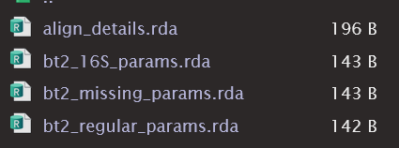
Using Data in Your R Package
Store data in data/ using usethis::use_data()
Saves objects as .rda files, accessible with data("object_name")
Use inst/extdata/ for raw files (e.g., CSV, FASTA)
Load with system.file("extdata", "file.csv", package = "yourpkg")
Include example datasets to support:
Function examples (@examples)
Vignettes and tutorials
Unit tests and demos
Document each dataset in R/ with roxygen2 comments and @format tag

Slide 42
Resources: Data in your package
Check out the R Packages book chapter:
https://r-pkgs.org/data.html
Accessing your data without CHECK problems:
https://coolbutuseless.github.io/2018/12/10/r-packages-internal-and-external-data/
https://stackoverflow.com/questions/32964741/accessing-sysdata-rda-within-package-functions
Explain your external data origins (example):
https://github.com/wejlab/MetaScope/blob/devel/inst/script/extdata_explanations.Rmd

Slide 43
Wrapping Up

Slide 44
Your R Package Journey
Ask yourself:
Do I have code that I keep reusing that would be better off as a package?
How can I help Evan build this R package that he is Very Excited about?
How can I improve my current package(s)?

Slide 45





Resources: Current WEJLAB Package Developers
Who to ask for help in the lab:
Maintainers
Aubrey (MetaScope, LegATo, TBSignatureProfiler)
Jessica (animalcules, BatchQC)
Contributors
Sean (MetaScope)
Yaoan (BatchQC)
Howard (BatchQC)

Slide 46
Resources: Outside the Lab
📘 R Packages (2nd Edition)
Comprehensive online book by Hadley Wickham & Jenny Bryan https://r-pkgs.org/
🧾 RStudio Package Development Cheatsheet Quick reference for package structure, documentation, and tools https://rawgit.com/rstudio/cheatsheets/main/package-development.pdf
🛠️ devtools & usethis Documentation Tools to streamline package creation and maintenance https://devtools.r-lib.org/ https://usethis.r-lib.org/
📦 CRAN Task View: R Packages Overview of tools and best practices for package development https://cran.r-project.org/web/views/
🧪 testthat Package Guide Framework for writing unit tests in R https://testthat.r-lib.org/

Slide 47
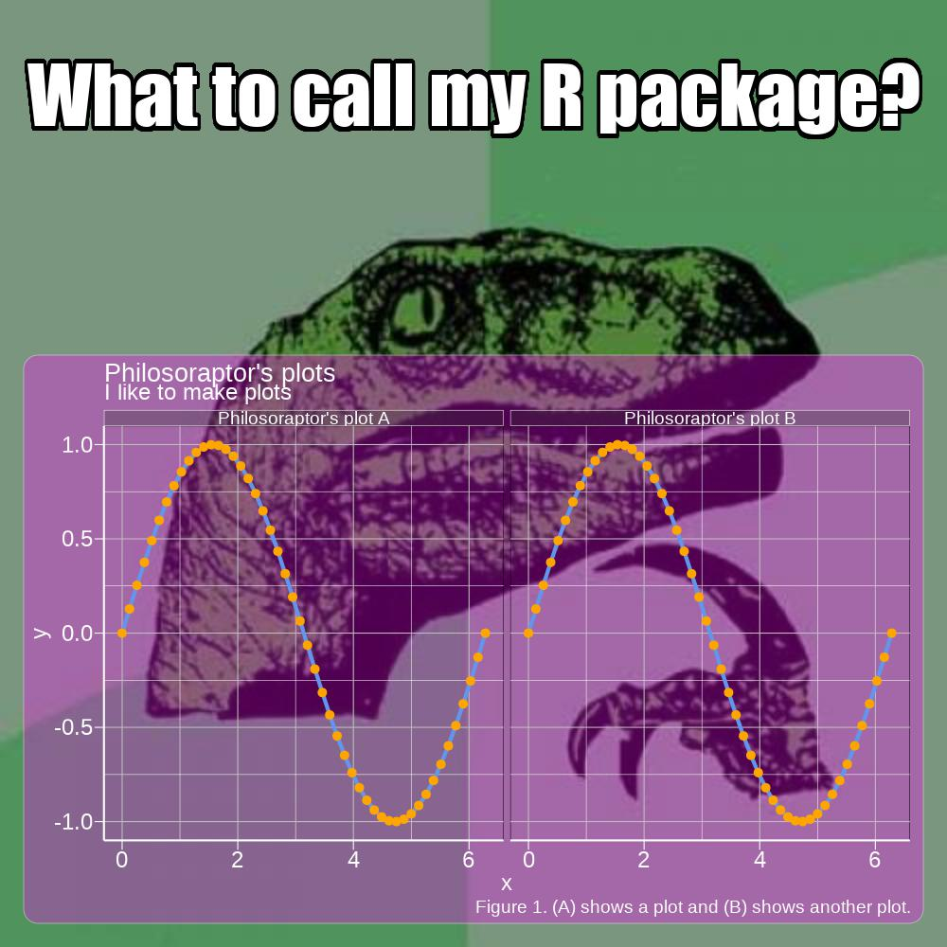

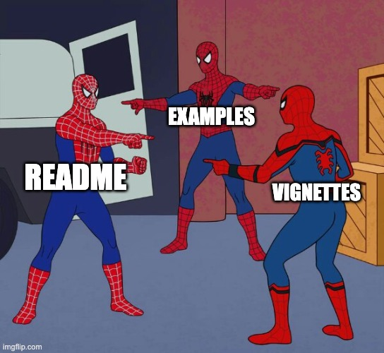
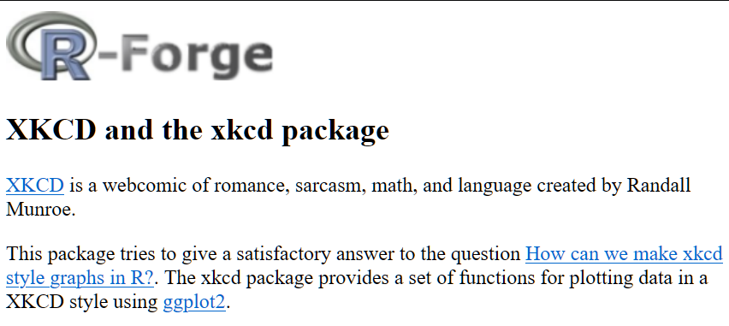
Q&A / Discussion

